Slide 1
Information coding in CA1 Hippocampus in an Aversive-Stimulus based treadmill running task in head-fixed mice Samsoon Inayat, Brendan McAllister, Jianjun Sun, Bruce McNaughton, Majid Mohajerani
Sam Inayat
June 29, 2020

Slide 2
Background - Theories of information coding in hippocampus
Spatial
Cognitive Map Theory (O’Keefe, Nadel, Burgess)
Path-Integration Theory (McNaughton)
Temporal
Time Cells (Eichenbaum)
Non-spatial
Auditory (Tank)
Hippocampus as a Sequence Generator (Buszaki)

Slide 3
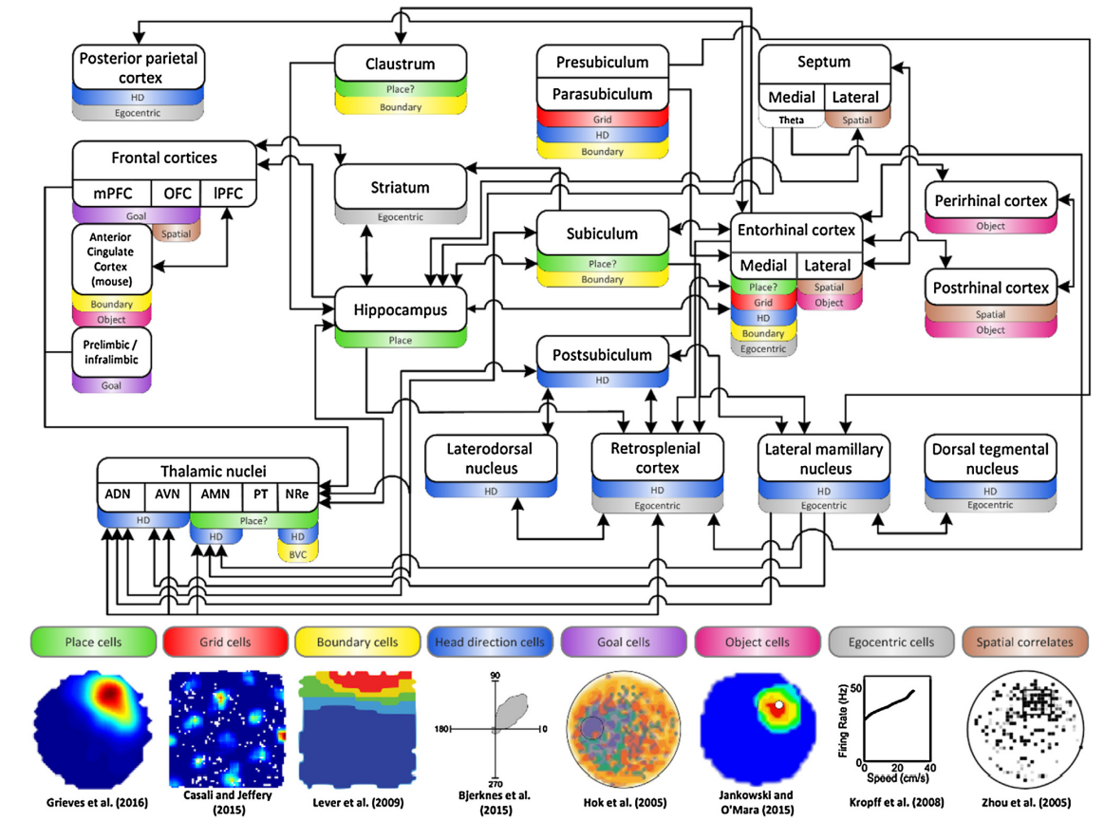
Spatial representation in the brain

Slide 4
Cognitive-map theory vs path-integration theory
Cognitive-Map
Path-Integration
Sensory-Map
Allocentric Representation
Relationships between landmarks are stored in memory
Place cell firing determined by sensory-map when animal recognizes a pattern of configuration of sensory cues or a boundary for example
Preconfigured Path-Integrating Chart
Ideothetic Representation
Relationships between landmarks are known after the animals moves
Place cell firing determined by distance from a sensory-cue. Sensory cues reset the path-integrator to reduce path-integration error

Slide 5
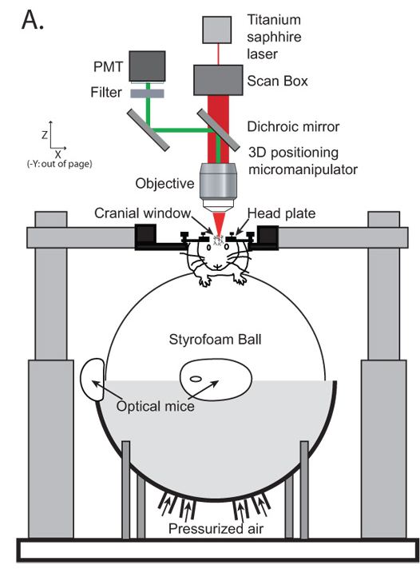
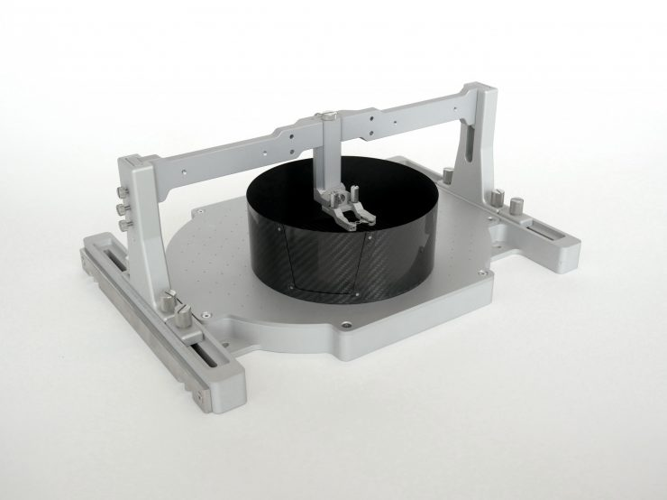
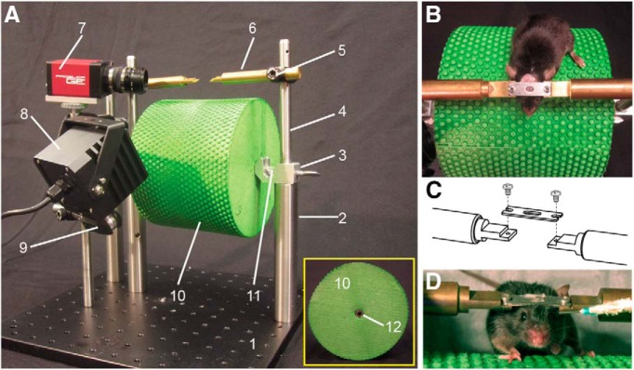
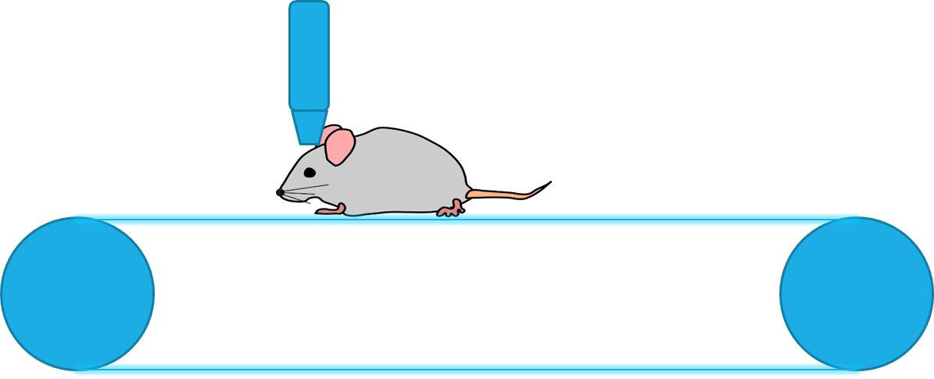
Current behavioral paradigms with head-fixed mice for finding spatially tuned cells
Two-dimensional movement
Running on a floating spherical ball
Visual stimuli presented using virtual reality
Tactile stimuli using ball with textured surface
Running on a floating 2D flat surface
One-dimensional movement
Running on a large cylinder
Running on a linear treadmill
https://www.neurotar.com/lataukset/whole-device-narrow-clamp.jpg
(Dombeck, Khabbaz et al. 2007)
Common to all paradigms → Motivation for running
Water deprivation of animals and operant conditioning with water rewards
Training takes 3weeks or more
(Heiney, Wohl et al. 2014)
Functional Imaging
Treadmill

Slide 6

Motivation for a novel behavioral paradigm based on aversive stimulus
Is it possible to train mice to run in response to an aversive stimulus?
Can we reduce training time using this paradigm compared to reward-based paradigm
What might be the conditions to train mice with an aversive stimulus such as air-puff?
Will we get spatially tuned cells if mice run on a treadmill in response to a continuous air-puff on a blank belt devoid of sensory cues?
Hypothesis was that since the air-puff onset is the only reference point which makes the animal move, cells will fire at fixed distances from there according to Path-Integration Theory.
Can we develop a behavioral protocol with this paradigm to test different theories?

Slide 7
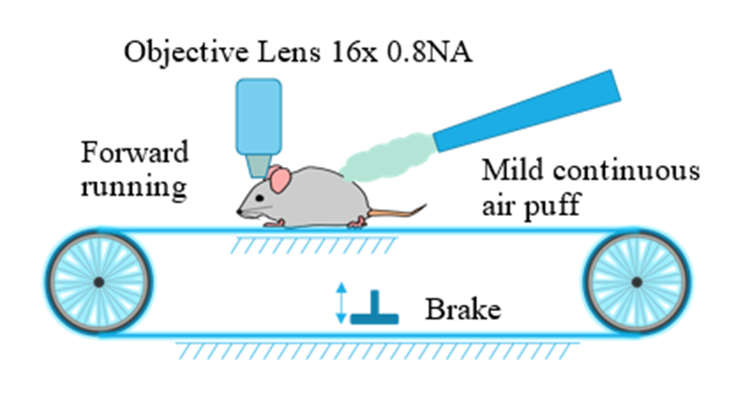
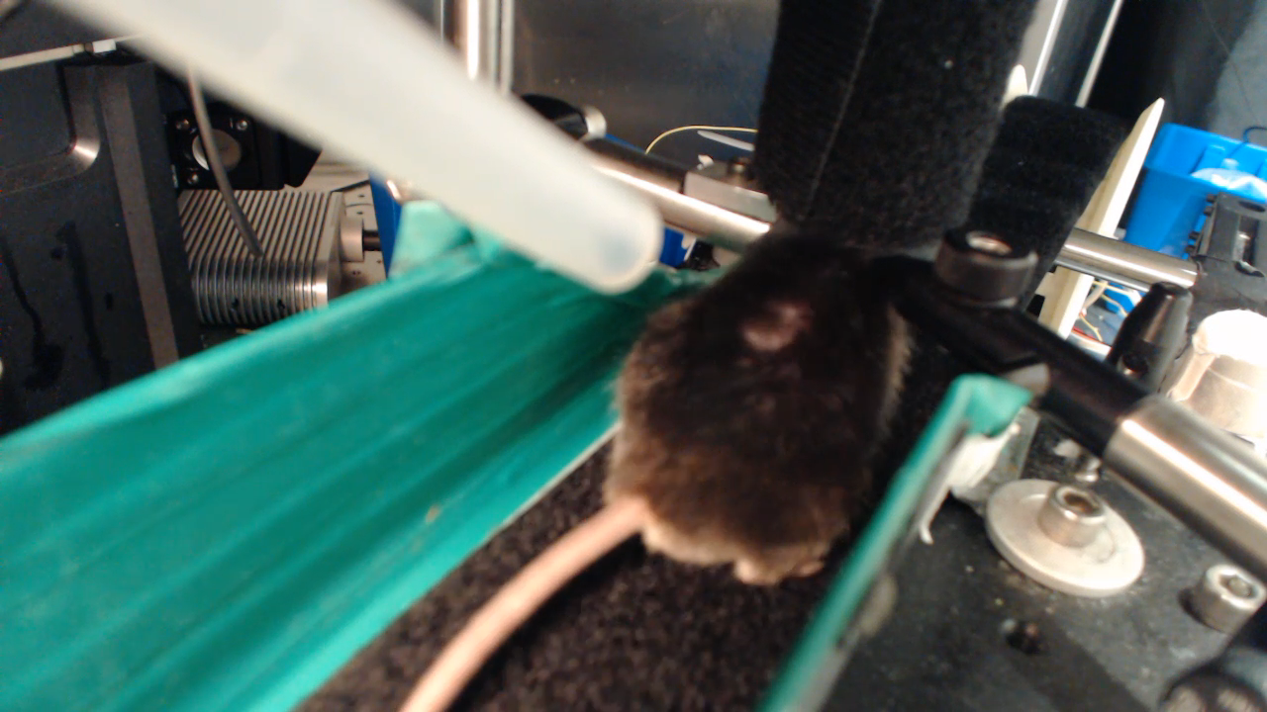
Novel behavioral paradigm Move and stop the animal at will
Motivation for running
Aversive stimulus and operant conditioning to run a desired fixed distance before the aversive stimulus would stop
Shorter training time expected compared to water reward based paradigm
Treadmill
Possible to create a mismatch between self-motion and sensory cues
Stopping the animal at will with a brake
Notes:
Two frames of references:
Air puff frame of reference
Belt frame of reference

Slide 8
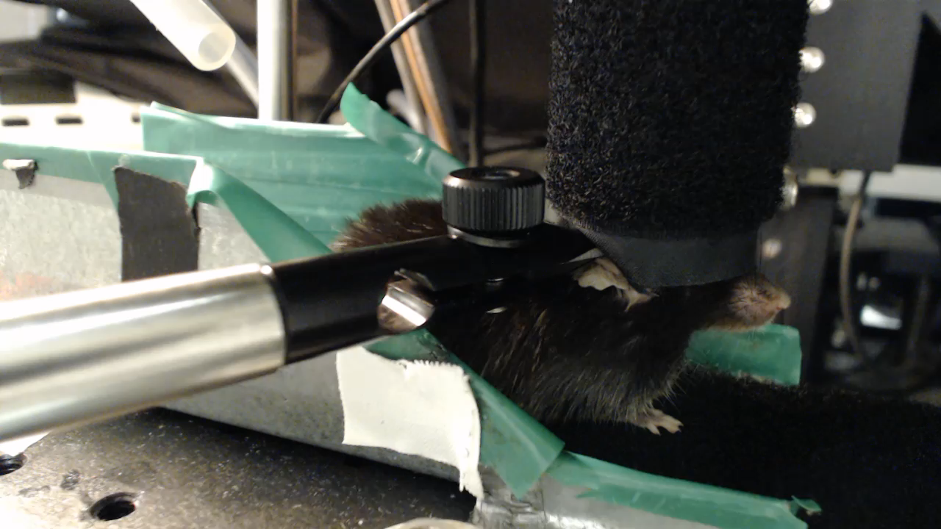
Behavioral training – make the animals run in response to the air puff
Animals have to run a fixed distance before the air puff would stop
Starting distance 30cm on day 1 and if in a trial the animal’s average speed is above 7 cm/sec then distance is increased by15 cm
Max time animals stay on the treadmill is ~25mins
Animals take 3-6 days to learn to traverse the whole belt ~142 cm with an average speed above 7 cm/sec

Slide 9
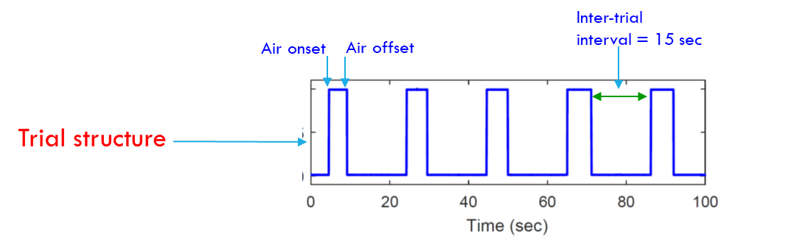
Trial structure for training and Two frames of references
Air puff frame of reference
Belt frame of reference
Intertrial-Period

Slide 10
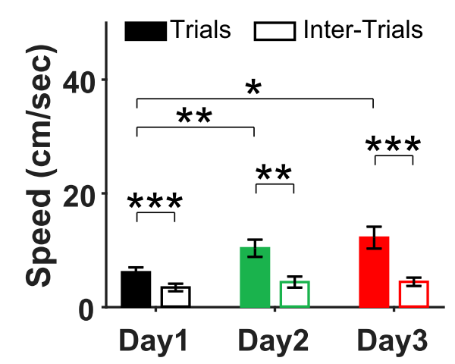
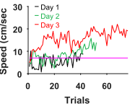
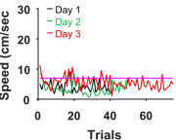
Results – speed →Air-puff Training
Repeated Measures ANOVA
N = 9
Trial Number
Inter-Trial Number

Slide 11

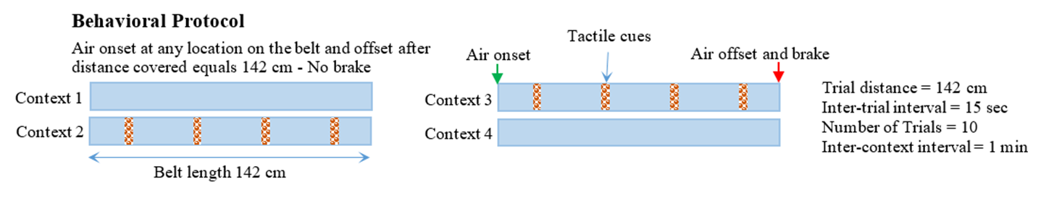
Testing protocol (different Belt conditions)
Presentation Sequence
10 trials
10 trials
10 trials
10 trials
Condition-1
1 minute gap to put cues on belt
Condition-2
1 min gap
Condition-3
1 min gap to remove cues from belt
Condition-4
Inter-trial
interval = 15 sec
Air onset
Air offset
Trial structure

Slide 12
Condition-1
Place/Time Cell
X
Path Integration input only
External Sensory Input
Internal Path Integration
Air Puff
Visual
Tactile
Auditory
Olfactory
Gustatory
Urination
Optic flow
Vestibular
Proprioception
Motion
Hypothesis: Place cell responses would be primarily driven by inputs from path integrators anchored to the air puff onset
Notes:
1) Presumably most place responses are driven by internal path integrators

Slide 13
Condition-2
Visuo-Tactile Cues
Place Cell
External Sensory Input
Internal Path Integration
Air Puff
Visual
Tactile
Auditory
Olfactory
Gustatory
Optic flow
Vestibular
Proprioception
Motion
Mismatch
in individual
Trials
(Inconsistent)
The addition of sensory cues will not markedly increase the number of place cells because sensory cues are not aligned with motion
Notes:
1) Single sensory input and see place cell responses? Presumable most place responses are driven by internal path integrators
2) We create a mismatch between external environment and internal path integration → we might see place cell firing
3) We can introduce sensory cues and see their effect

Slide 14
Condition-3
Air puff offset
Air puff onset
Brake
Place Cell
External Sensory Input
Internal Path Integration
Air Puff
Visual
Tactile
Auditory
Olfactory
Gustatory
Optic flow
Vestibular
Proprioception
Motion
Matching
in individual
Trials
(Consistent belt frame of reference)
A large number of place cells will emerge upon the alignment of sensory cues with motion

Slide 15
Condition-4
Air puff offset
Air puff onset
Brake
Place Cell
X
External Sensory Input
Internal Path Integration
Air Puff
Visual
Tactile
Auditory
Olfactory
Gustatory
Optic flow
Vestibular
Proprioception
Motion
Place cells will be primarily driven by path integration as there are no sensory cues on the belt. The number of place cells however will be larger than those in context 2 and context 1 because in the previous environment (Context 3) there was an elaborate sensory map and path integration was recruited.

Slide 16
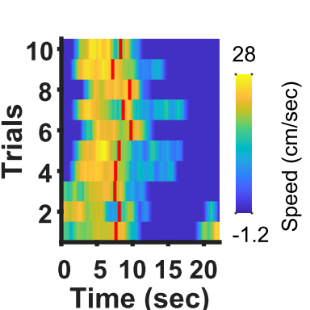
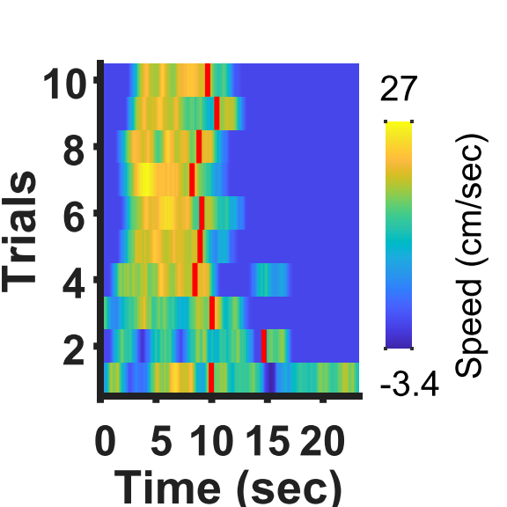
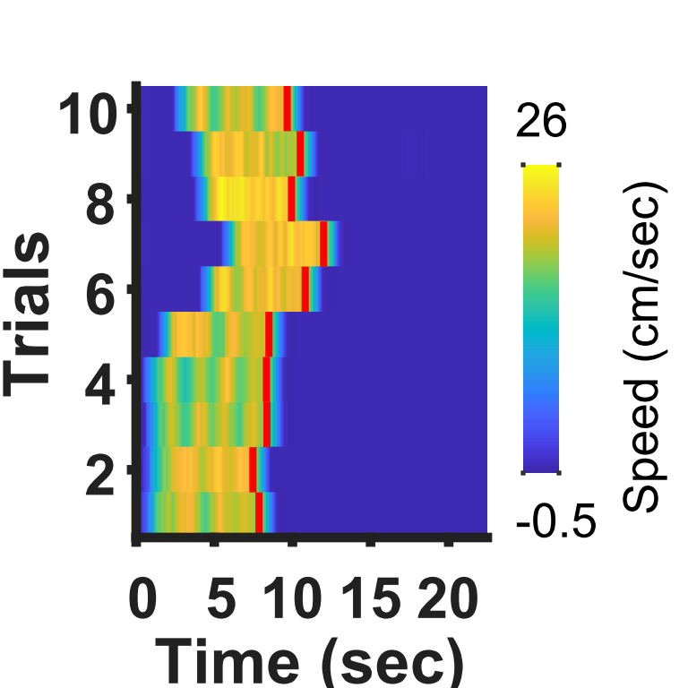
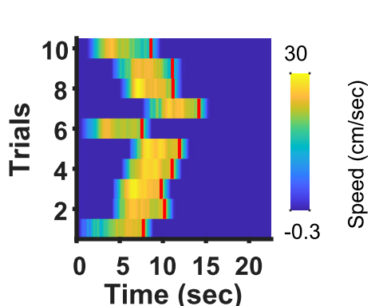
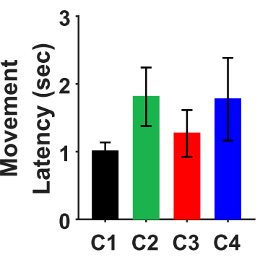
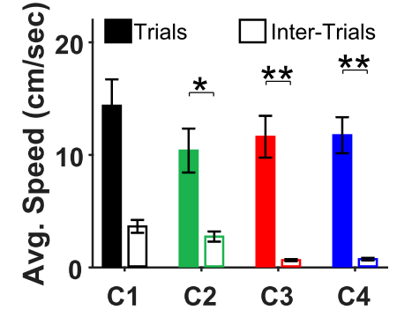
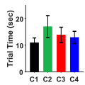
Results – testing with 4-conditions behavioral paradigm
Condition 1
Condition 2
Condition 3
Condition 4
Single Animal
Repeated Measures ANOVA (N = 5)

Slide 17
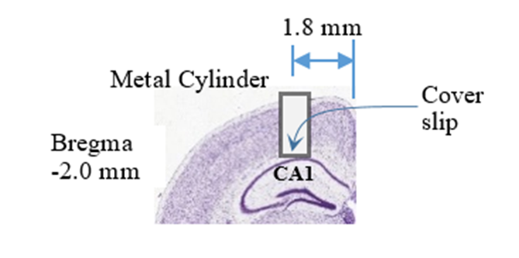
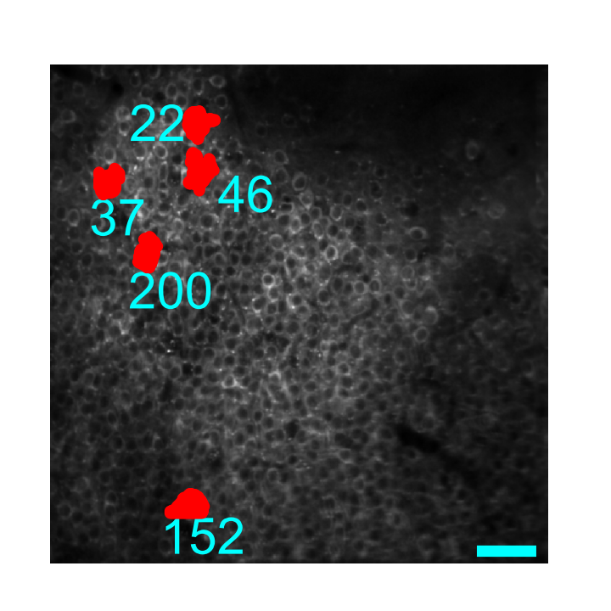
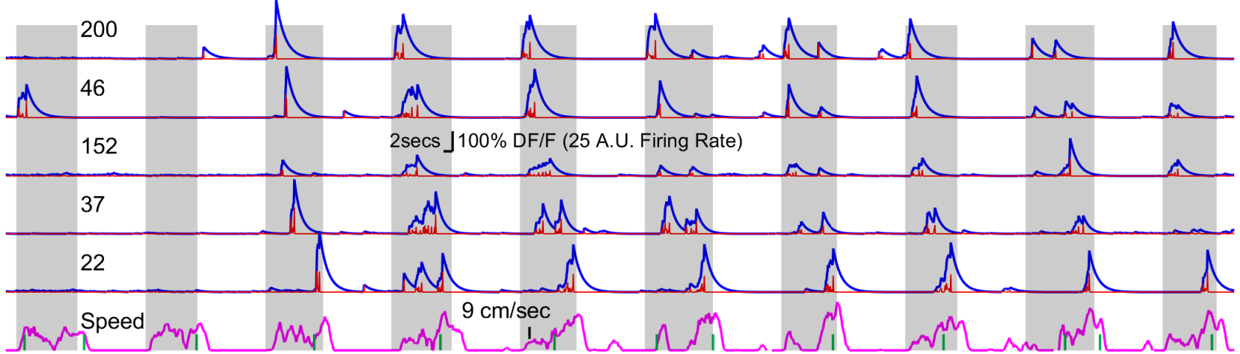
Results – Ca imaging
Depth
1st plane @ 125um
2nd plane @ 175um
Representative average image and calcium traces from Condition 1
Gray regions (air-puff trials), Calcium Signal (fitted), Deconvolved Spike Rate, Speed, Belt Lap Marker
Number of Cells (Suite2P)
Animal 1 = 532, Animal 2 = 601, Animal 3 = 704, Animal 4 = 487, Animal 5 = 350

Slide 18
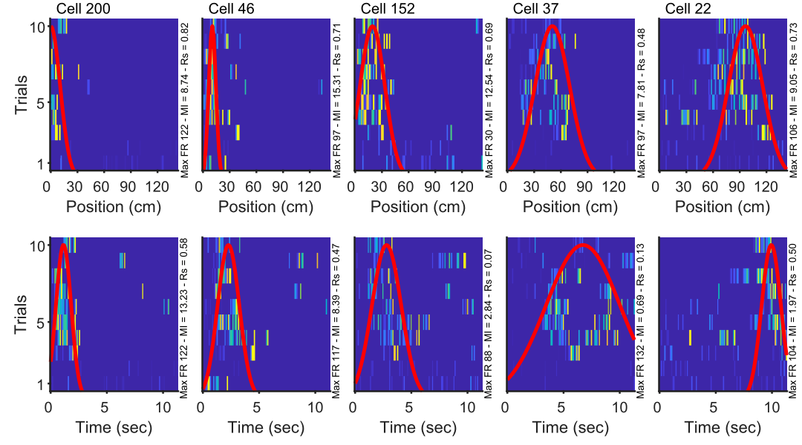
Results – raster plots (condition 1)
Representative
Air - Dist
Air - Time
Belt - Dist
AirI - Time

Slide 19

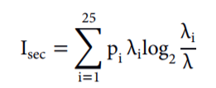
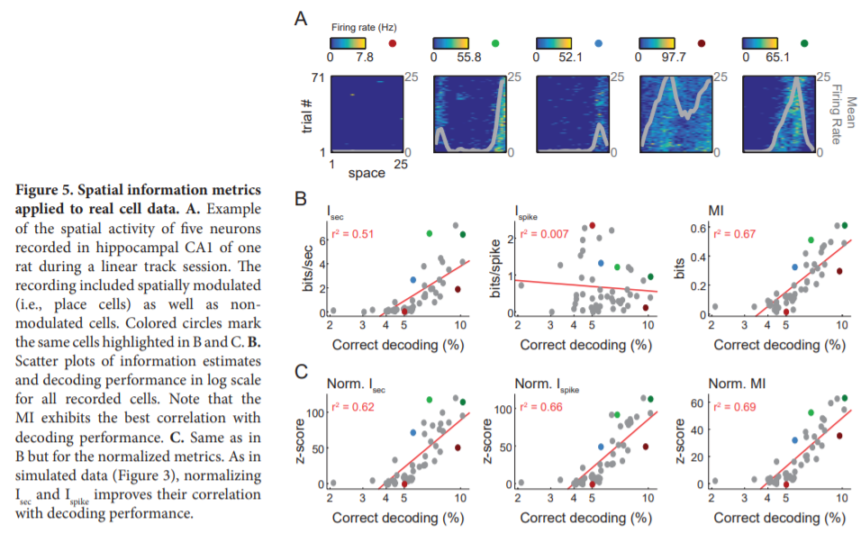
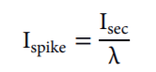
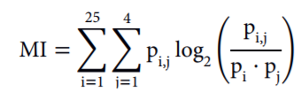
Mutual information z-score

Slide 20
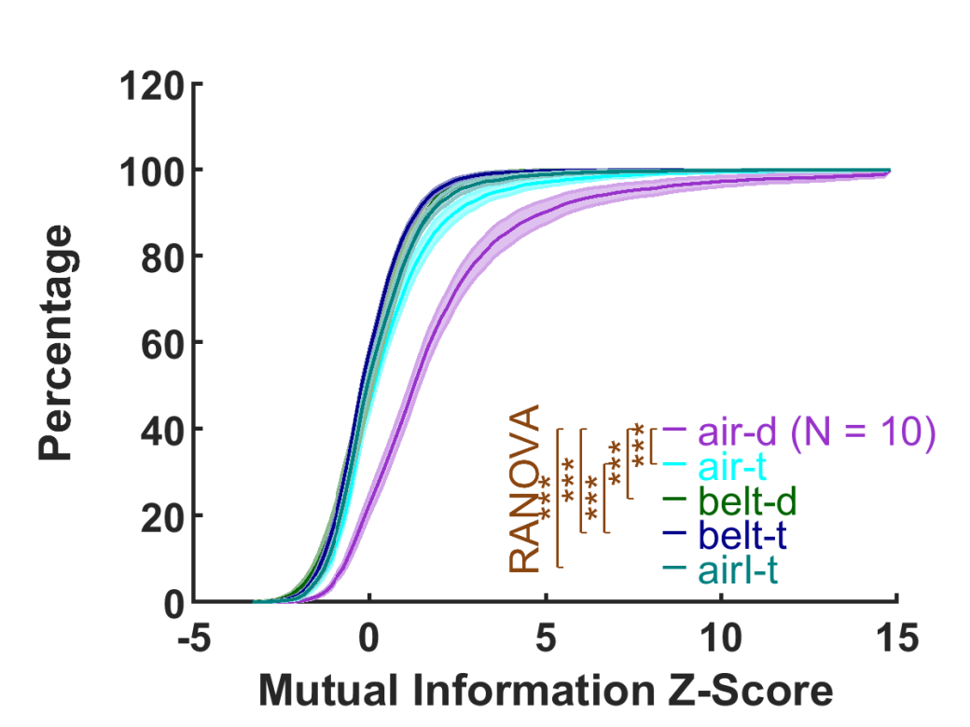
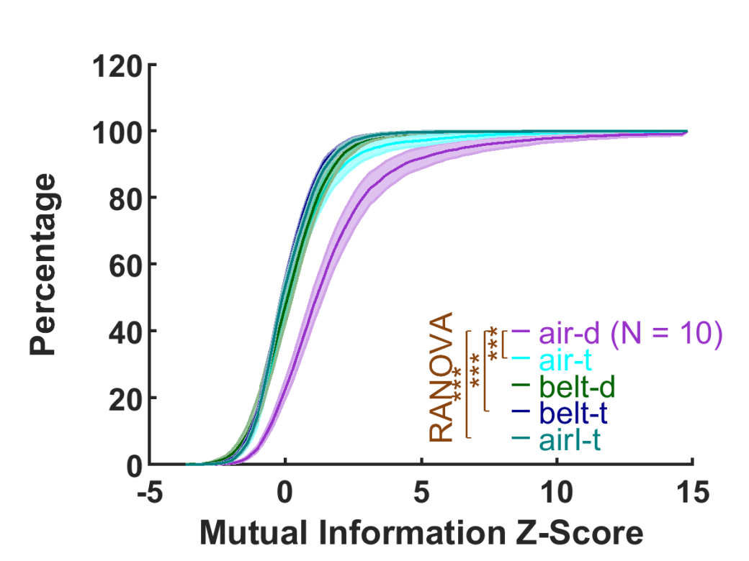
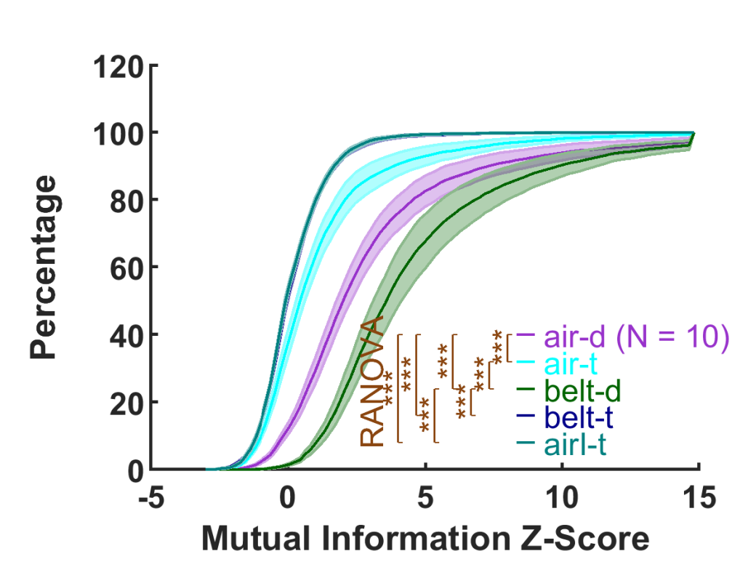
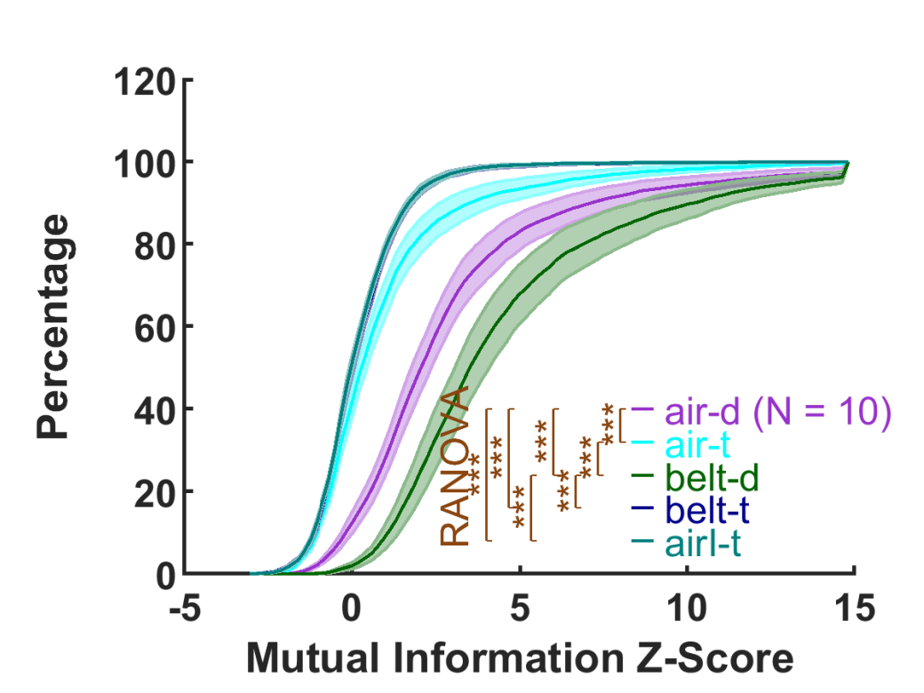
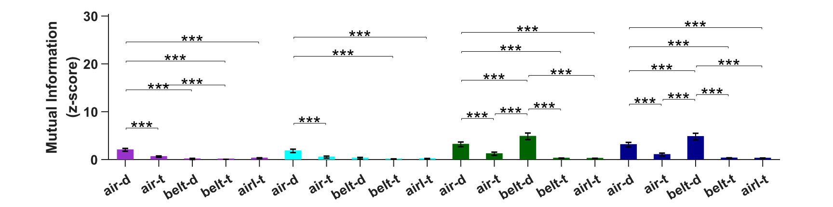
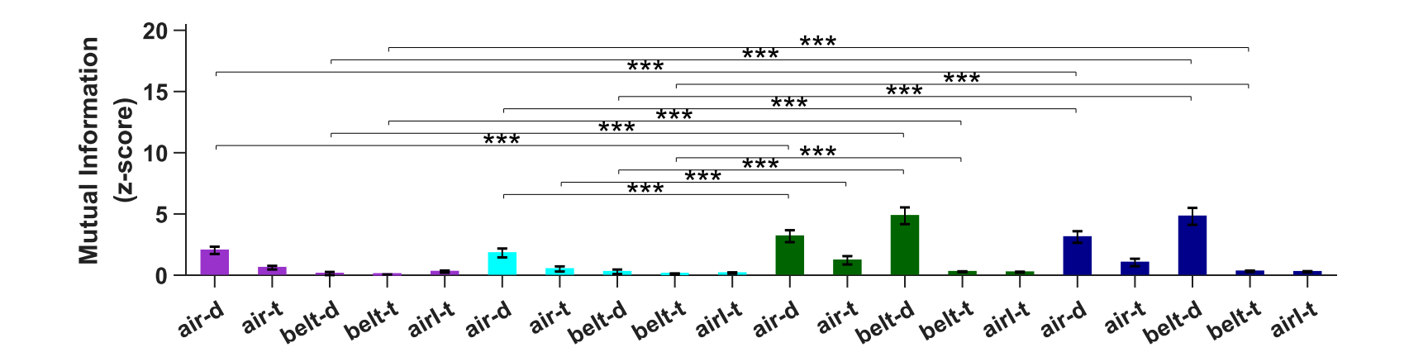
Results – distributions of mI – z-score – all cells
Condition 1
Condition 2
Condition 3
Condition 4
Repeated Measures ANOVA (N = 10)
Number of ROIs (Suite2P)
617, 686, 900, 692, 771, 912, 430, 1552, 416, 427, 462, 398, 370

Slide 21
What criteria to classify cells into tuned vs untuned?

Slide 22
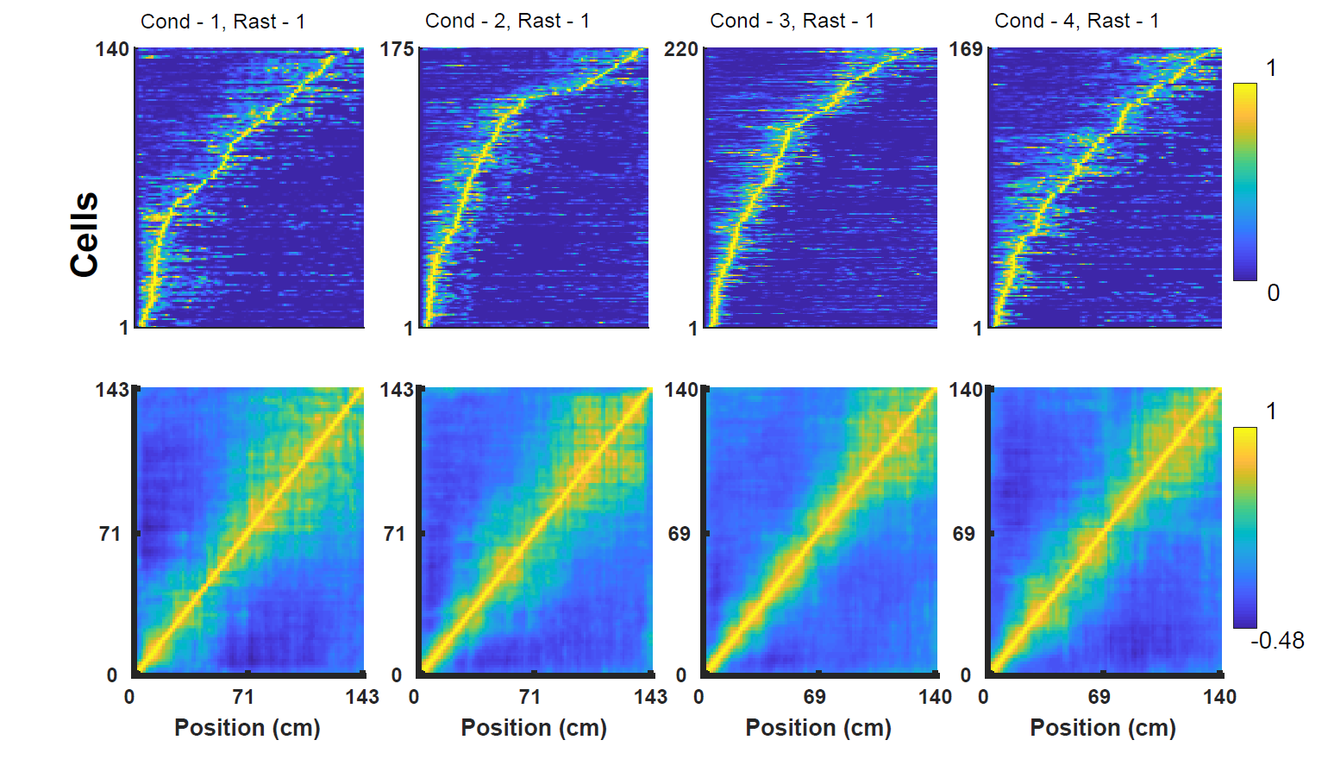
Place cells → zMI > 3, RS > 0.4, Fcenter 0 – 140, fwidth 1-120
Animal 2

Slide 23
Air-Time
Animal 2

Slide 24
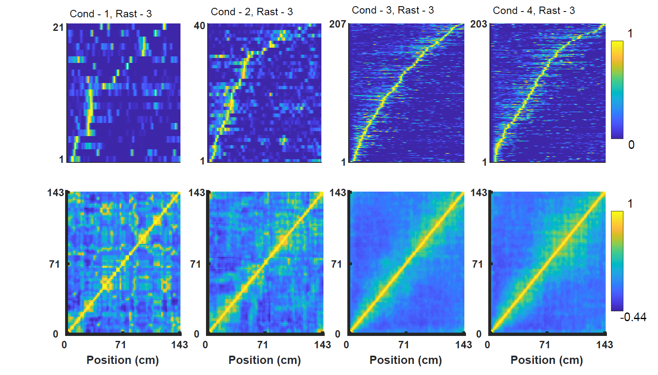
Belt-distance
Animal 3

Slide 25
Air-intertrial-time
Animal 2

Slide 26
Place cells → zMI > 3, RS > 0.4, Fcenter 0 – 140, fwidth 1-120

Slide 27
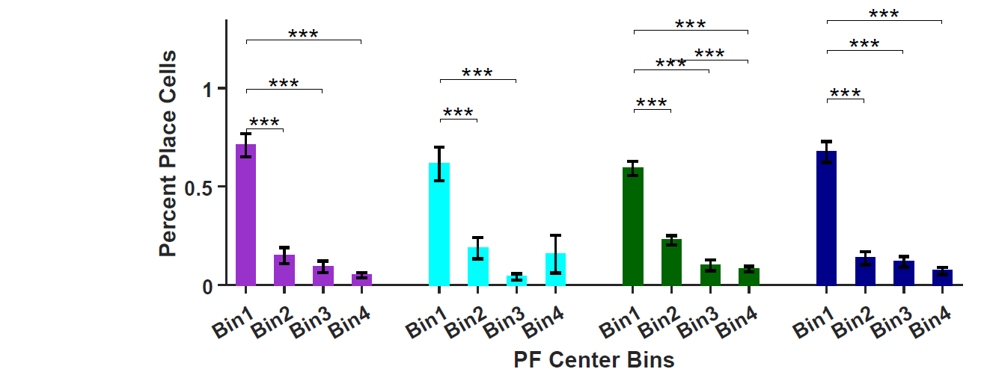
Distribution of place cells on the belt

Slide 28
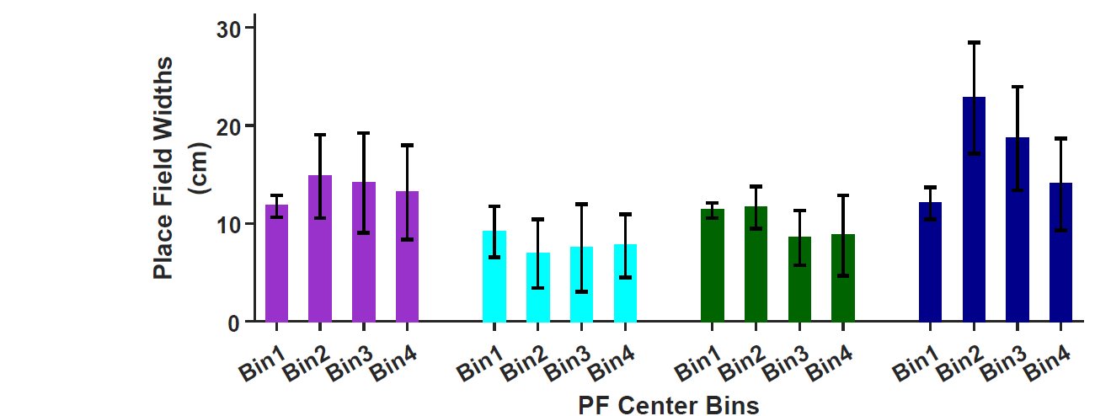
Place field widths on the belt

Slide 29
Interim conclusions
Is it possible to train mice to run in response to an aversive stimulus?
Can we reduce training time using this paradigm compared to reward-based paradigm
What might be the conditions to train mice with an aversive stimulus such as air-puff?
Will we get spatially tuned cells if mice run on a treadmill in response to a continuous air-puff on a blank belt devoid of sensory cues?
Hypothesis was that since the air-puff onset is the only reference point which makes the animal move, cells will fire at fixed distances from there according to Path-Integration Theory.
Can we develop a behavioral protocol with this paradigm to explore and test Path-Integration theory?

Slide 30
Interim conclusions
Mice can be trained to run continuously in response to continuous air puff
On average 3 days are sufficient to train animals to achieve speeds > 7 cm/sec. This time <<< what is required for reward-based paradigms
Spatially tuned cells – Cells encoding distance
Air Puff Frame of Reference – Distance from air-puff onset
Belt Frame of Reference – Distance from belt marker
Temporally Tuned Cells – Cells encoding interval ?
During trials as well as inter-trials
Temporally Tuned Cells are mostly close to air-puff onset or offset (have good distance encoding as well)

Slide 31
Interim conclusions
Addition of sensory cues doesn’t necessarily improve zMI but alignment of self-motion and environment map (Condition 3) improves zMI
Hysteresis in condition 4 – Perhaps pure path integration cells

Slide 32
Ongoing Work – more analysis →manuscript
Distinct population of cells encoding two frames of references?
Formation of fields
Tuning Vs Trials … it takes about two trials for the formation of field and later there is a shift in the field center
What is the role of sensory cues present on the belt on field formation → in condition 3 fields form in trial 1
Field properties
Widths Vs Centers
Remapping
Field remapping
Rate remapping
Use of GLMs for finding distance vs time tuning (Eichenbaum type analysis)

Slide 33
Hippocampus sequence generator

Slide 34




acknowledgements
Majid Mohajerani
Bruce McNaughton
Jaira Ranger
Di Shao
Animal Care Staff
Mohajerani lab members
McNaughton lab members
Amanda Mauthe-Kaddoura
Ian Whishaw
Thank you
Brendan McAllister
Jianjun Sun

